Slide 1

Topics
•
•
Use of finally clause in Exception Handling
Some
Important
Facts
About
Exceptions
1
Object-Oriented Programming Using Java

Slide 2
Use of finally clause (statement)
•
finally block
operations resources.
finally block
in general used to perform certain house keeping
such
as
closing
files
or
releasing system
•
may be added immediately after try block or after
the last catch block.
•
finally
block when present
is guaranteed
to
execute
regardless of whether an exception is thrown or not.
•
If required , finally block can
generated within a try block.
be
used
to
handle
any
exception
2
Object-Oriented Programming Using Java

Slide 3
finally clause Syntax
// Immediately After try() block
// After the last catch() block
try
{
try
{
…………………..
…………………..
} // End of try
finally
{
…………………..
…………………..
} // End of finally catch(Exception-Type-1 e) { … } catch(Exception-Type-2 e) { … }
…
catch(Exception-Type-N e) { … }
…………………..
…………………..
} // End of try
catch(Exception-Type-1 e) { … }
catch(Exception-Type-2 e) { … }
… catch(Exception-Type-N e) { … } finally
{
…………………..
…………………..
} // End of finally
3
Object-Oriented Programming Using Java

Slide 4
finally clause Example
// File Name ExceptionDemo.java
class ExampleFinallyClause
{
public static void main(String args[])
{
int a=10;
int b = 20;
try // Outer Try
{
int b1=Integer.parseInt(args[0]);
int x = a/(a-b1);
try
{
// Inner try
int y = b/(b-b1);
} // End of Inner try finally
{
System.out.println("Inner Block executed");
} // End of finally clause
} // End of Outer try finally
{
System.out.println("Outer Block executed");
} // End of finally clause
} // End of main() Method
} // End of class
4
Object-Oriented Programming Using Java

Slide 5
finally clause Example …
java ExampleFinallyClause
Outer Block executed
Exception in thread "main" java.lang.ArrayIndexOutOfBoundsException: 0 [Partial Output
Shown]
java ExampleFinallyClause 45
Inner Block executed
Outer Block executed
java ExampleFinallyClause 10
Outer Block executed
Exception in thread "main" java.lang.ArithmeticException: / by zero [Partial Output Shown]
java ExampleFinallyClause 20
Inner Block executed
Outer Block executed
Exception in thread "main" java.lang.ArithmeticException: / by zero [Partial Output Shown]
5
Object-Oriented Programming Using Java

Slide 6
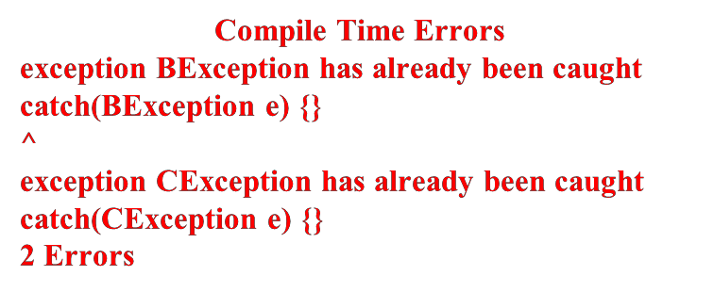
Some Important Facts About
Exceptions
•
Fact I : A super class exception type can catch all
exceptions. So, while writing catch blocks , catch
sub
sub
class
class
exceptions first and then super
class AException extends RuntimeException class BException extends AException
class CException extends AException class Demo
{
public static void main(String args[])
{
try
{
int a=10;
}
catch(AException e) { catch(BException e) { catch(CException e) {
} // End of method
class
{
{
{
exceptions
}
}
}
RuntimeException
AException
BException
CException
}
}
}
} // End of class
6
Object-Oriented Programming Using Java

Slide 7
Some Important Facts About
Exceptions
•
Fact I : A super class exception type can catch all
exceptions. So, while writing catch blocks , catch
sub
sub
class
class
exceptions first and then super
class AException extends RuntimeException class BException extends AException
class CException extends AException class Demo
{
public static void main(String args[])
{
try
{
int a=10;
}
catch(BException e) { catch(CException e) { catch(AException e) {
} // End of method
class
{
{
{
exceptions
}
}
}
RuntimeException
AException
BException
CException
}
}
}
NO
ERROR
} // End of class
7
Object-Oriented Programming Using Java

Slide 8
Some Important Facts About
Exceptions
•
Fact
II
: An
overridden
method
in
sub-class
can
not
throw
an
exception broader and stronger than the
// File Name : ExceptionDemo.java
import java.io.*;
class A
{
public void display() throws IOException
{
}
}
class B extends A
{
public void display() throws Exception
{
}
}
method
of the super class
Compile-Time Error
ExceptionDemo.java:11:
display() in B cannot
override display() in A;
overridden method does
not throw
java.lang.Exception
public void display()
throws Exception
^
1 error
8
Object-Oriented Programming Using Java

Slide 9
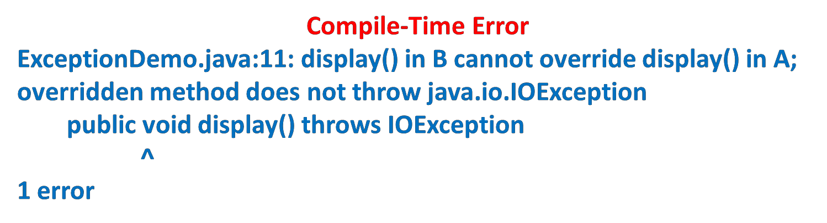
Some Important Facts About
Exceptions
•
Fact
II
: An
overridden
method
in
sub-class
can
not
throw
an
exception broader and stronger than the method
// File Name : ExceptionDemo.java
import java.io.*;
class A
{
public void display() throws RuntimeException
{
}
}
class B extends A
{
public void display() throws IOException
{
}
}
of
the
super
class
gramming Using Java
9
Object-Oriented Pro

Slide 10
Thank
You
10
Object-Oriented Programming Using Java

